Slide 1

RISK ANALYSIS OF TRUCKS IN CALIFORNIA
Group 9
Jyothi Praveen Seelam
Snehitha Penumaka
Pradeep Mohanish
Aman Sahu
Keshav Sarraf
Shaik, Ikramulla Shareef
Singareddy, Om Simha Reddy

Slide 2

OBJECTIVE
Identify high risk drivers in the California state.
Offer Business Solutions by highlighting the drivers whose risk factor is greater than 7.0

Slide 3

User Stories
As a safety officer, I want to identify high-risk drivers in California, so that we can implement targeted interventions to reduce accidents and improve road safety.
As a fleet manager, I want to have insights into drivers' behaviors, such as lane departures and over-speeding, so that we can provide training and support to improve their driving habits.
As a data analyst, I want to analyze the dataset to identify drivers with a risk factor greater than 7.0, so that we can prioritize them for interventions and monitor their progress over time.

Slide 4
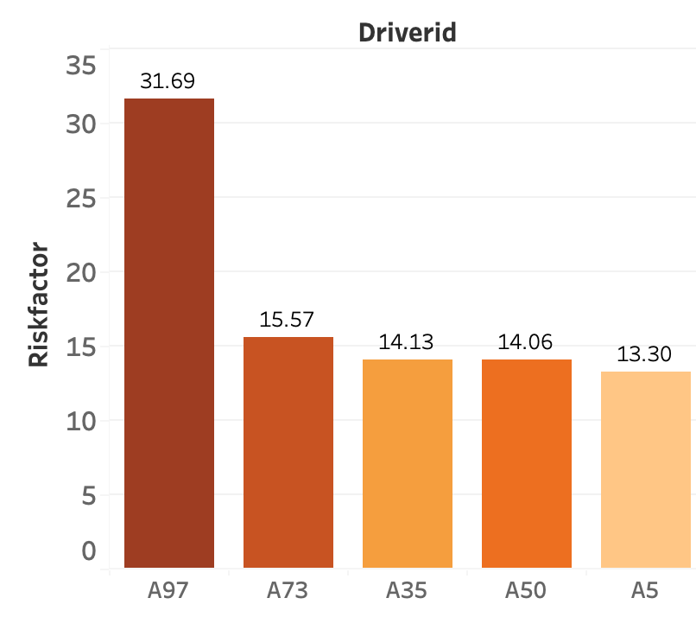
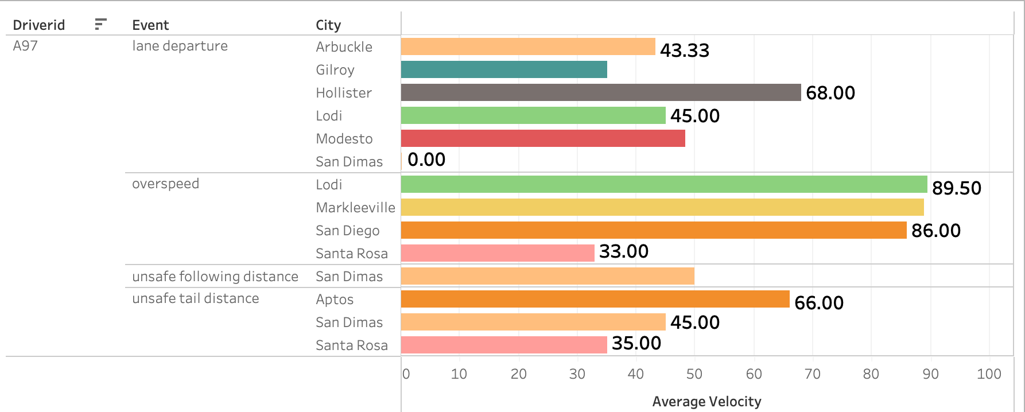
RISK ANALYSIS
A97 is the most risky.
Lane departures in Hollister (speed 68.0)
Unsafe tailgating (velocity 66.0)
High over-speeding in the Lodi, Markleeville, and San Diego (velocity 86.5)

Slide 5
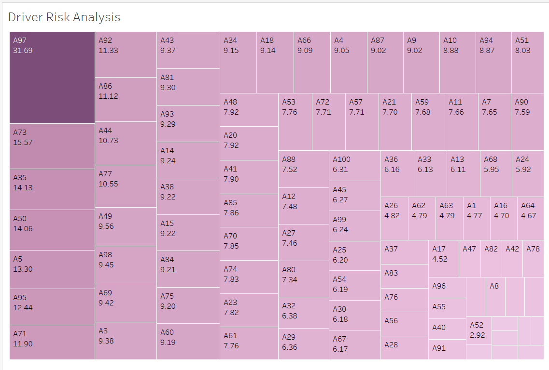
Risk Factor for Drivers

Slide 6
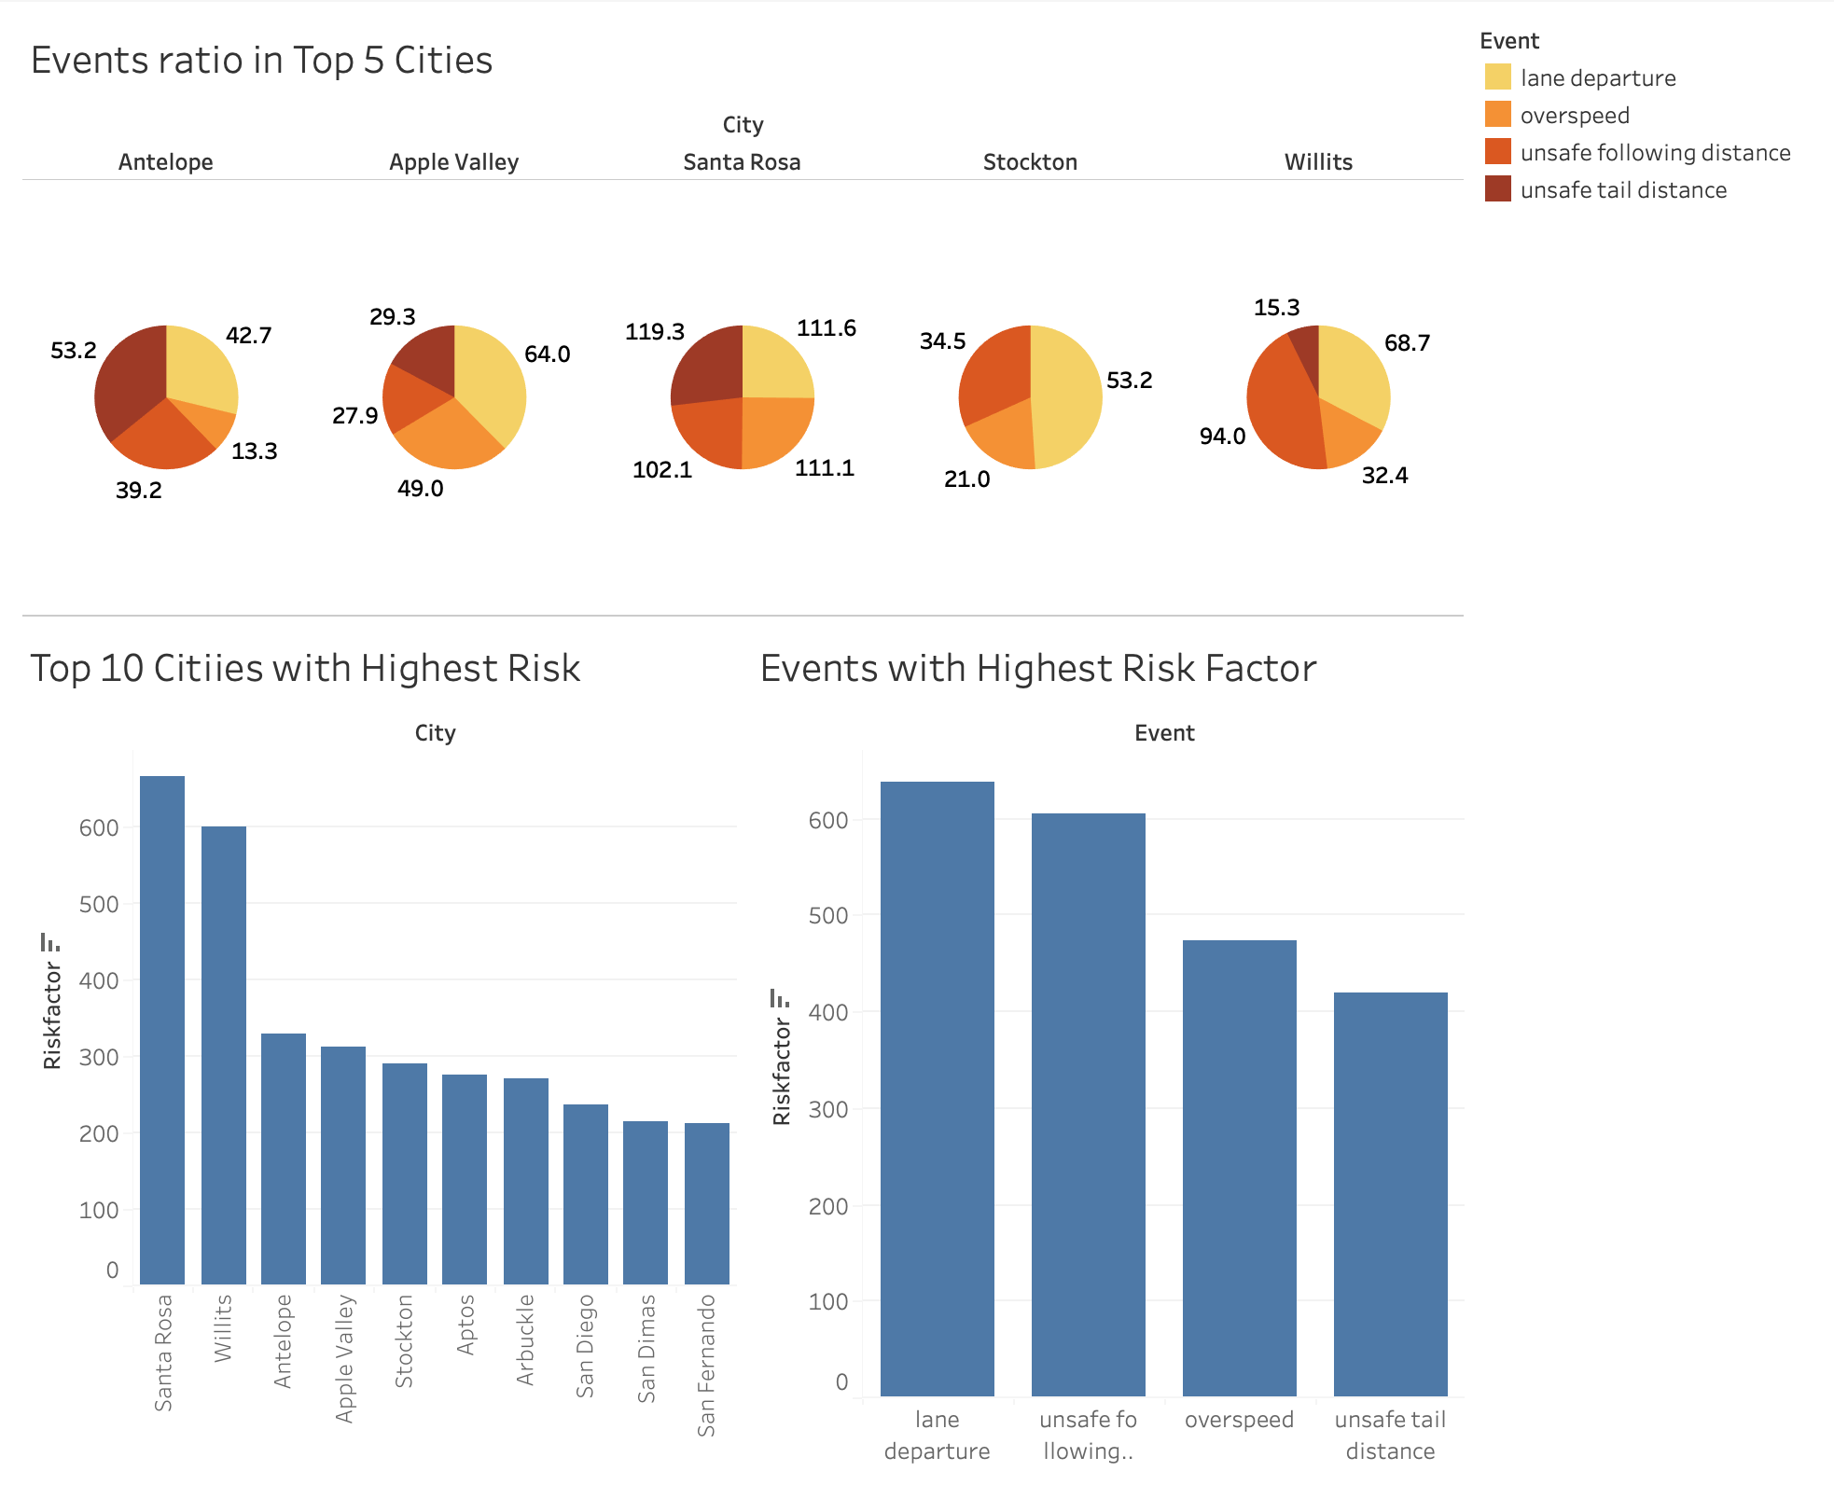
Analysis of Events: Key Risk Across Cities
Santa Rosa has highest overall risk (risk factor>600)
-> Significant issues with unsafe following distances indicating a critical need for targeted interventions.
Lane departure events has the highest risk factors among all other events across multiple cities.

Slide 7
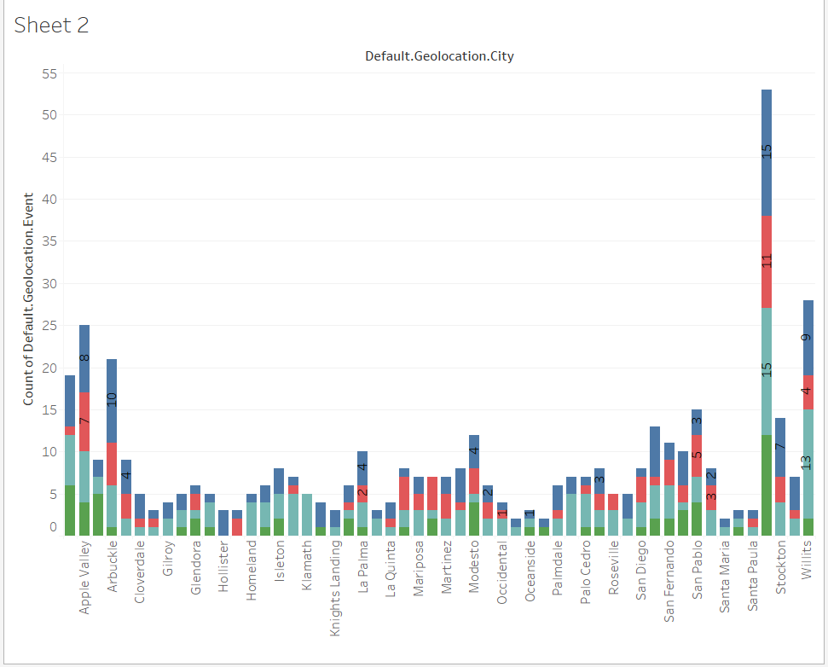
Events Analysis
Santa Rosa, Willits, and Apple Valley have highest incident rates
Oceano, Ojai, and Santa Maria have lowest incident rates.

Slide 8
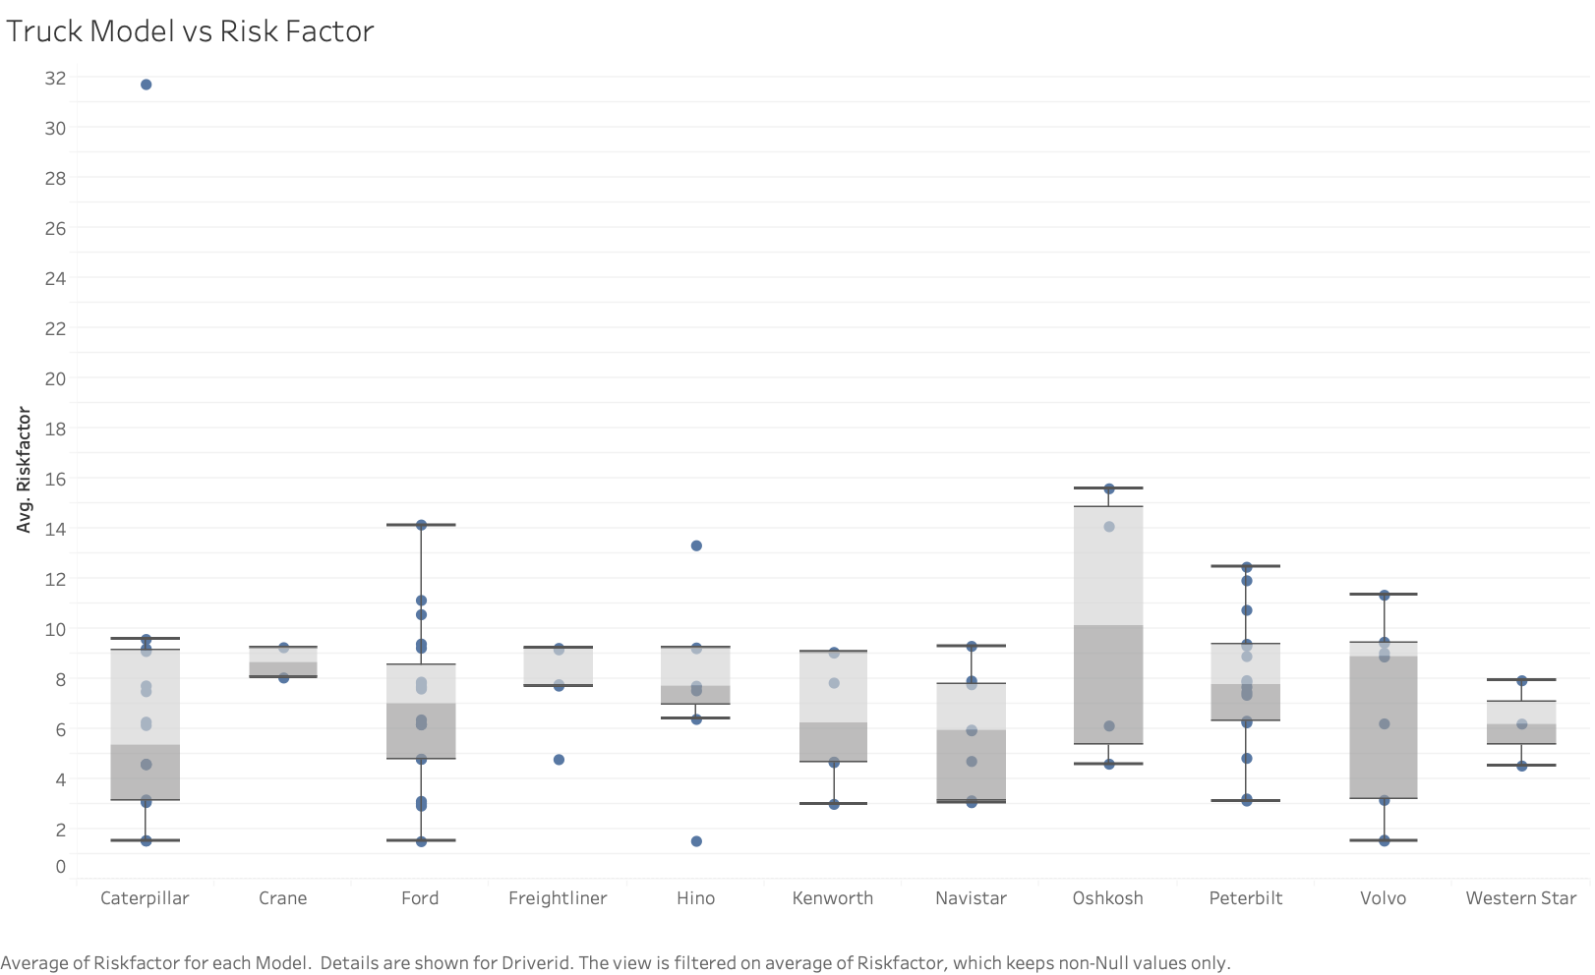
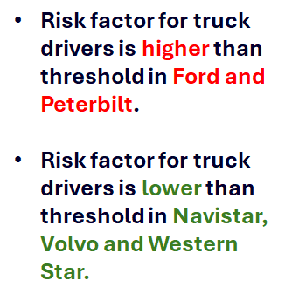
Truck Model Risk Factor Analysis

Slide 9
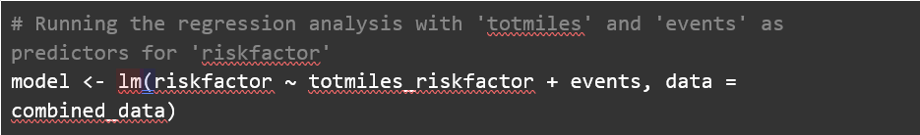
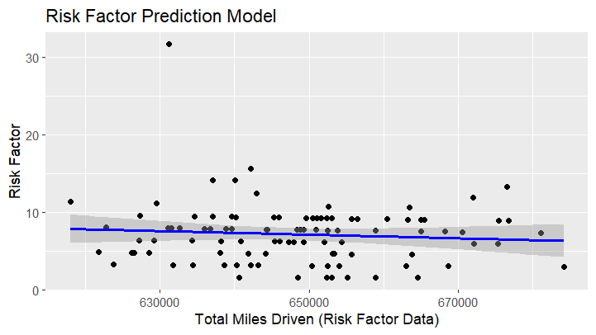
Regression Analysis

Slide 10
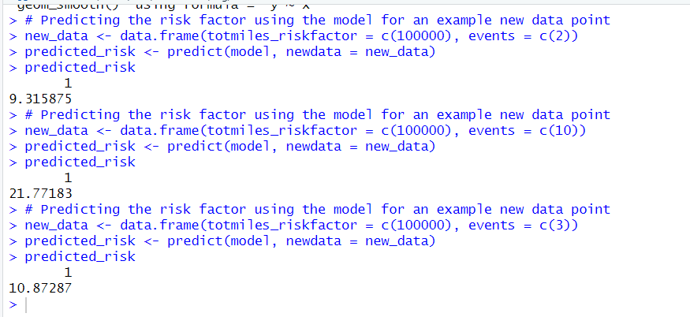
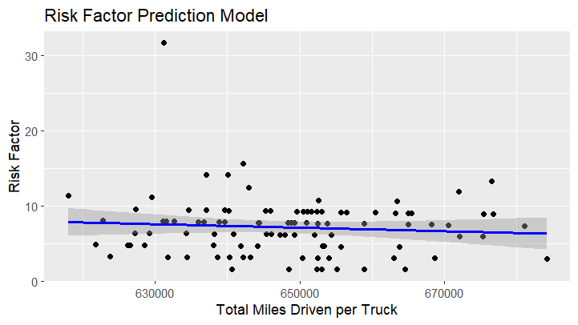
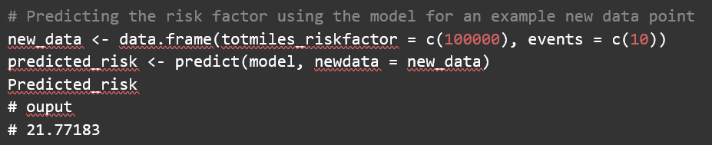

Slide 11
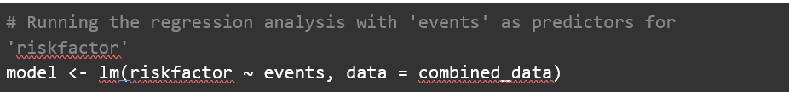
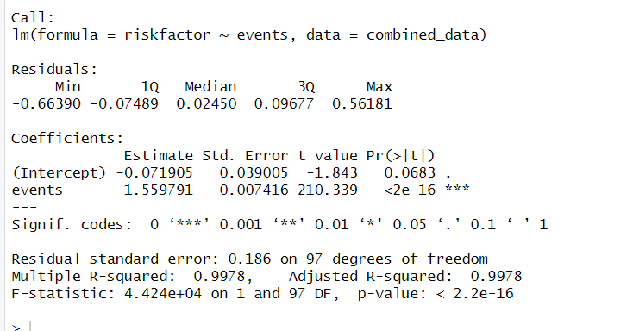
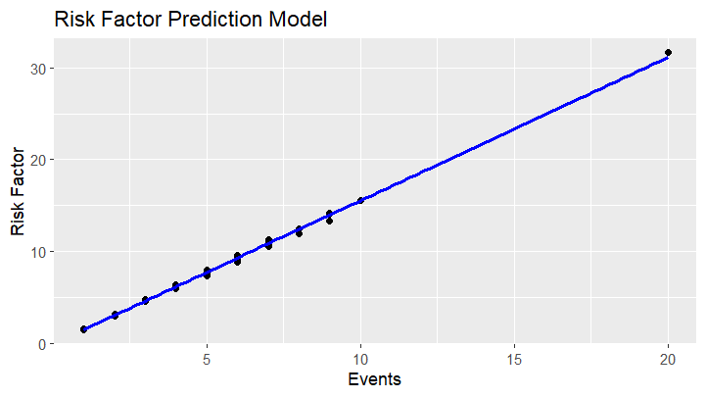
Regression Analysis

Slide 12
Violation Analysis
Surprisingly, Overspeeding is not the most “popular” violation seen in risky truck drivers.
How they are driving matters.
It could be the nature of traffic that leads to different driving habits

Slide 13
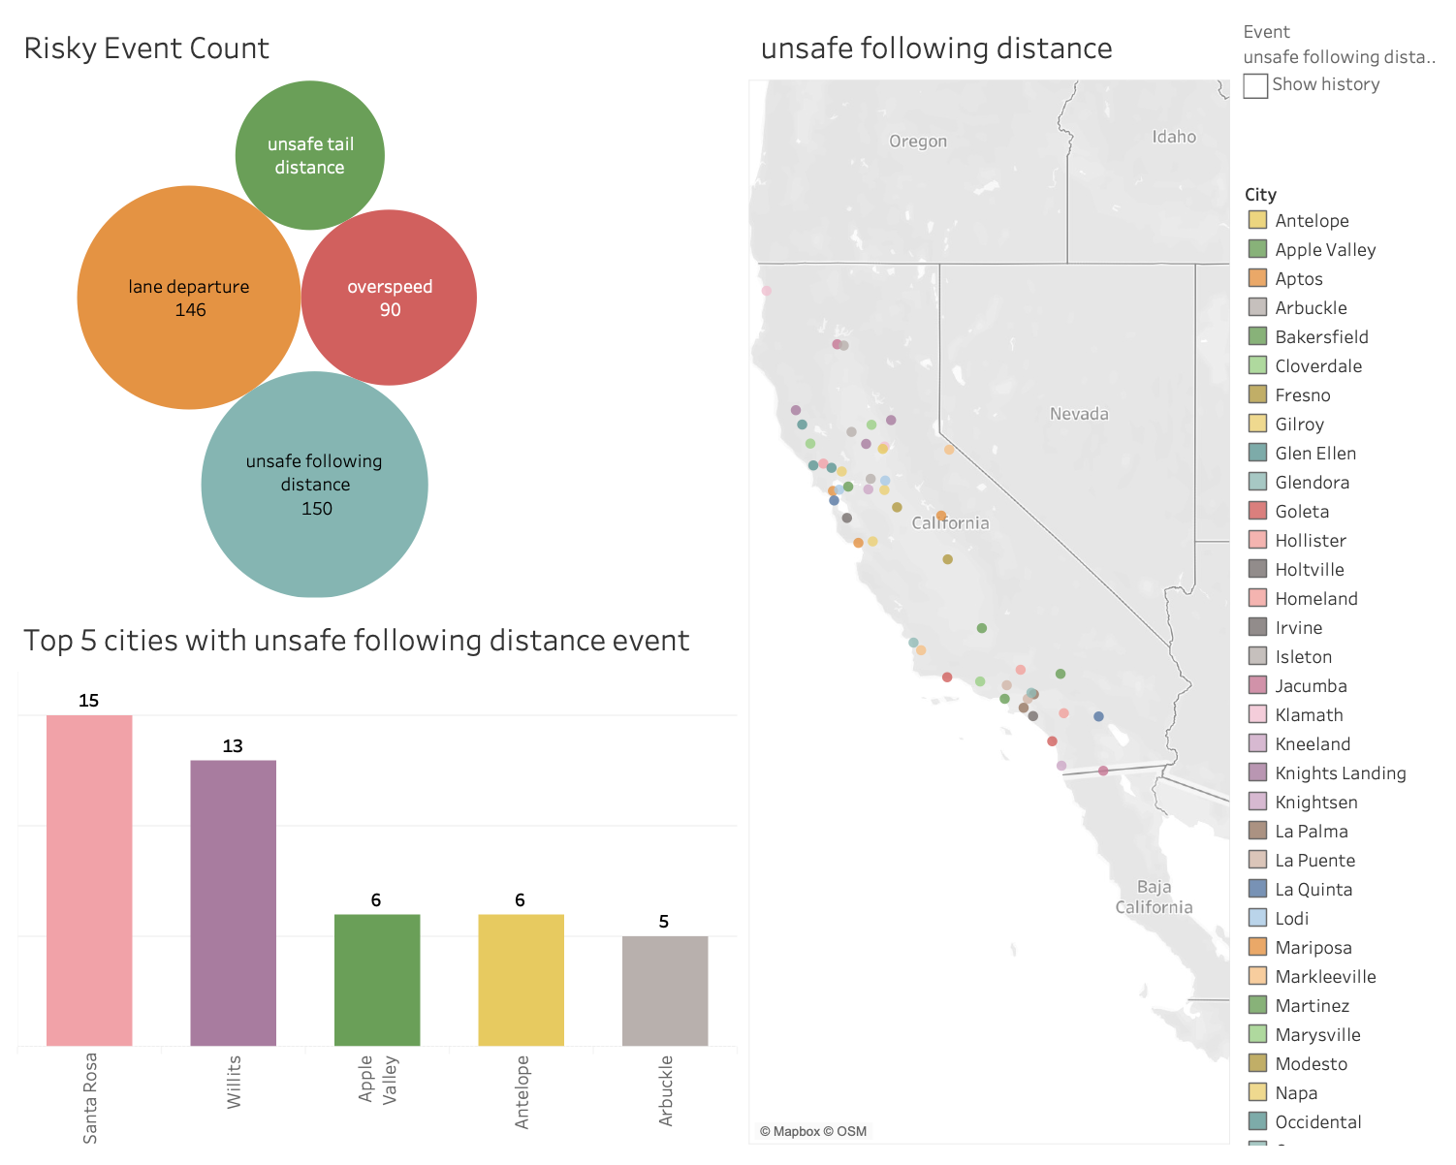
GEOGRAPHICAL DASHBOARD
Event count
Locations on Map
Top 5 Cities

Slide 14

Business Outcomes
Targeted Training for High-Risk Drivers
Focus on defensive driving techniques and safety regulation awareness.
Emphasize the importance of maintaining safe distances.
Incentives for Safe Driving
Reward drivers with a low risk factor and consistent safe driving records.
Motivate all drivers to prioritize road safety.
Collaboration with Authorities
Work with local law enforcement to boost traffic law enforcement.
Target areas with high incident rates and high-risk driver populations.
Real-Time Reporting and Monitoring
Implement systems for live tracking of driver behaviors and risk factors.
Use data to identify trends and enable proactive safety interventions.

Slide 15


